Slide 1
A Recommender System for Car Salesman
Applied Data Science Capstone
December 2019

Slide 2
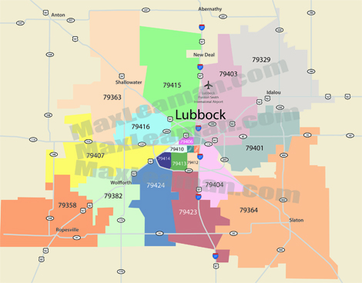

Slide 3
Synopsis
Part 1: Problem Description
There is a car salesman located in Dallas, Texas that is looking to expand his business to Lubbock, Texas.
The car salesman sells both brand new and used cars. The salesman wants to build a car shop in Lubbock which claims to have a budding student population.
The goal is to increase sales and improve business quality and processes.

Slide 4
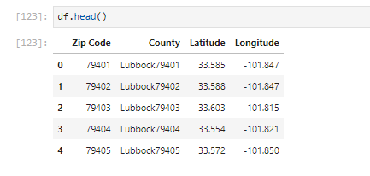
Data Needed
The geo-locational information about Lubbock, Texas can provide the salesman data needed to make his decision.
city of Lubbock – showing neighborhoods
Lubbock area connect – shows zip codes
Geonames – showing latitude and longitude

Slide 5
Interested Stakeholders
Car salesman
Parents/Students in Lubbock
City of Lubbock

Slide 6
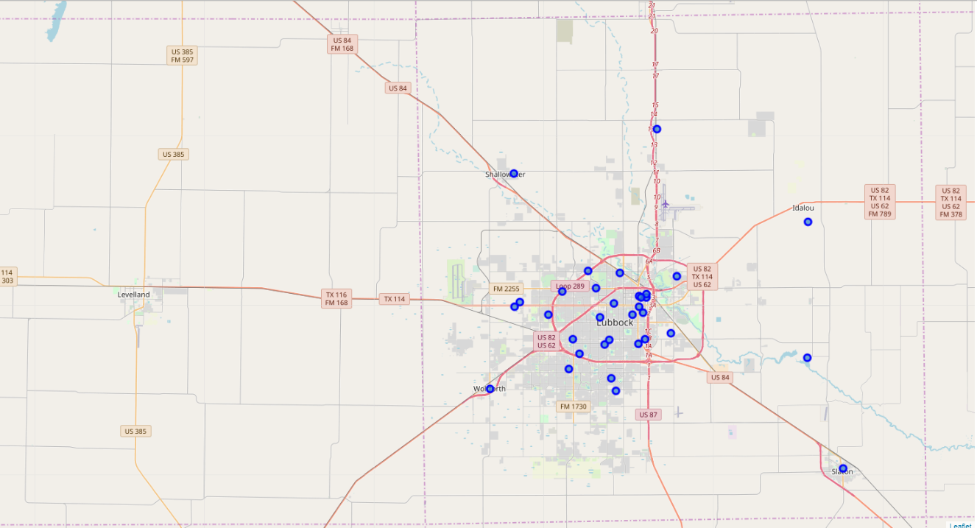
Methodology
Scraped and extracted data from websites
Use Foursquare API
Group data by neighborhoods
Perform clustering using k-means algorithm
Visualize using folium map

Slide 7
Methodology
Scraped and extracted data from websites
Use Foursquare API
Group data by neighborhoods
Perform clustering using k-means algorithm
Visualize using folium map

Slide 8
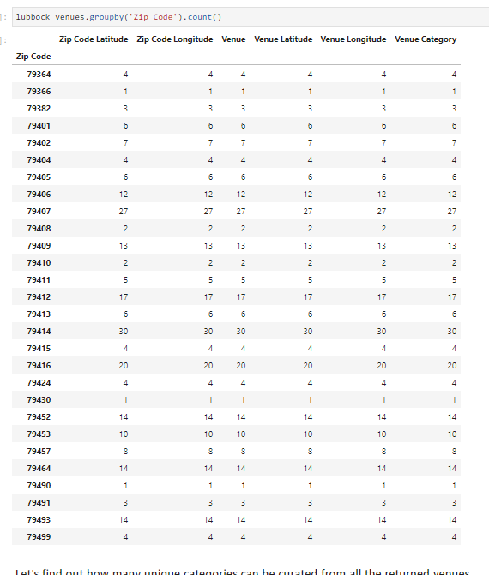
Results

Slide 9
Results
Cluster 0: Neighborhoods with a high occurrence of automotive shops
Cluster 1: Neighborhoods with some occurrence of automotive shops
Cluster 2: Neighborhoods with little occurrence of automotive shops
Cluster 3: Neighborhoods with very little occurrence of automotive shops
Cluster 4: Neighborhoods with no occurrence of automotive shops

Slide 10
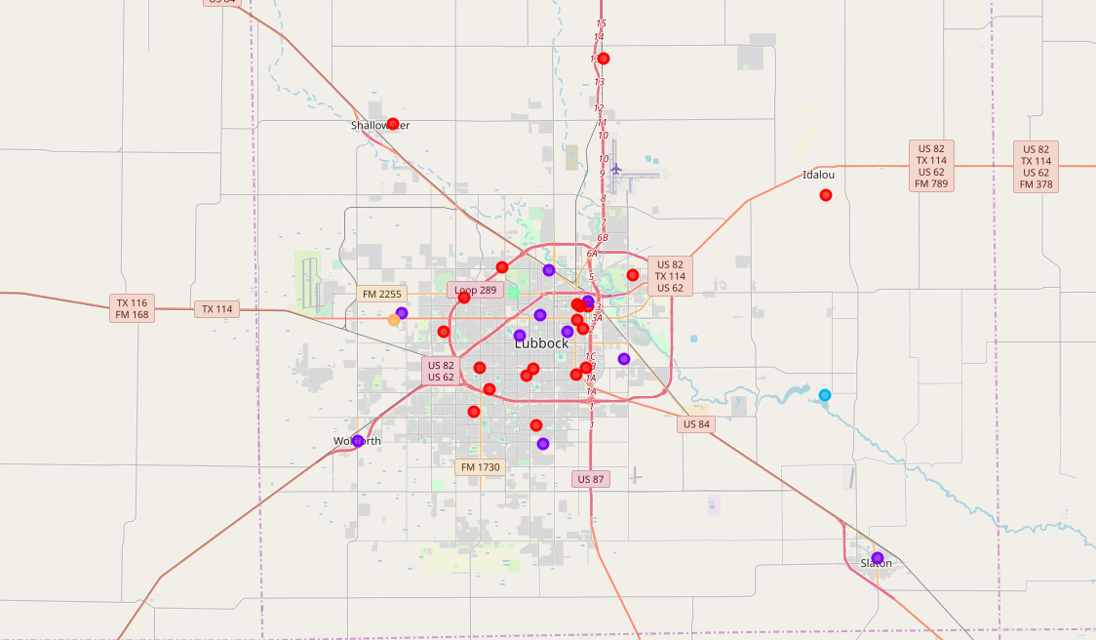
Results

Slide 11
Discussion
Most frequented area is neighborhood with zip code 79414.
Areas 79401 and 79402 closest to the University has the automotive shop
Analysis recommends that the car salesman can capitalize on these findings for car shops closer to the University

Slide 12
Discussion
Offers a unique selling proposition to market themselves to the students, parents and their families.
Avoid neighborhood 79403 which is majorly used for ranching and farming.
Neighborhoods 79490, 79430 and Ransom Canyon are sparsely populated and will not be advisable to set up car shops here.

Slide 13
Conclusion
Data analysis shows the need for car shops
Salesmen who wish to invest their business should set up car shop in areas where they are highly visible and marketable.
The neighborhoods in cluster 0 are the most preferred to set up a car shop

